Slide 1
BUSQOM 1080: Data Analysis for Business
Fall 2020
Lecture 2 (8/25)
Professor: Michael Hamilton

Slide 2
Course Specifics
Outline for today:
Overview of Rstudio’s interface [< 5 Mins]
Topic: Variable Assignment [5 Mins]
Topic: Variable Types [5 Mins]
Topic: Vectors in R [5 Mins]
Topic: Logical Operators (AND’s and OR’s) [5 Mins]
Assignment 2 is posted – Due 9/4 at 11:59

Slide 3
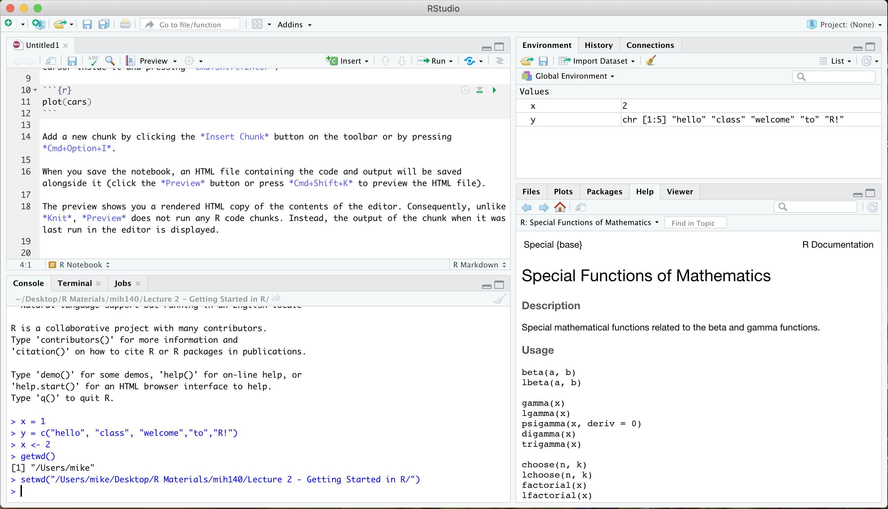
RStudio Interface
Console (1): Here you can type commands into R to be executed. You can see five commands I’ve already executed here.
(4)
Environment Tab (2): Here you can see what variables are currently defined and some summary information about them.
(2)
Files/Plots/Help (3): Here you can see documentation about functions, manage files, and view plots.
(1)
R Notebook: Not default, open by going to File->New File-> R Notebook. Then double click the collapsed console tab to have all four windows displayed. There is where you’ll save your code!
(3)

Slide 4
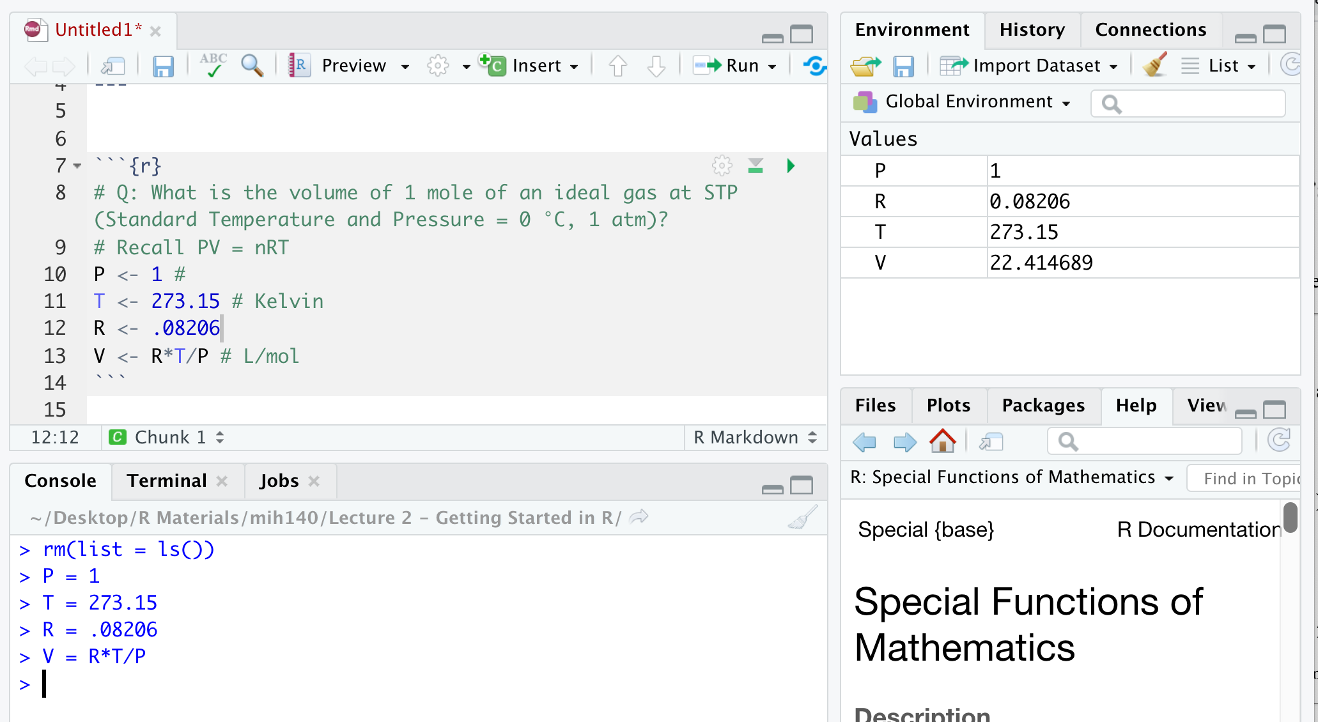
Topic: Variable Assignment
You can use R to perform numerical calculations and then save those calculations in variables.
Example:
> rm(list = ls()) cleared prev. vars.
In console, see the assignment of variables P, T, R, V
Listed in Env. Tab
Also saved in notebook tab.

Slide 5
Topic: Basic Variable/Data Types
In R there are six basic variable types: Character (char), Double, Integer (Int), Logical (bool), Complex, and Raw. The first four will be commonly used in this class. (Caveat: There’s also factors, more on this later)
Character: This type represents text, you can tell R a variable is a character by putting it in quotes “”
Try typing: > umpc <- “University of Pittsburgh Main Campus”
Double: This is the standard numeric type, it functions as a (real number)
Try typing: > pi
Integer: Integers are whole numbers e.g. 0, 1, 2, 3
Try typing: > c(typeof(as.integer(1)), typeof(1))
Logical: This data type corresponds to TRUE or FALSE.
Try typing: > x <- TRUE
Why do we care? Mixing variable types may have unexpected consequences (more on this in Group Activities)

Slide 6
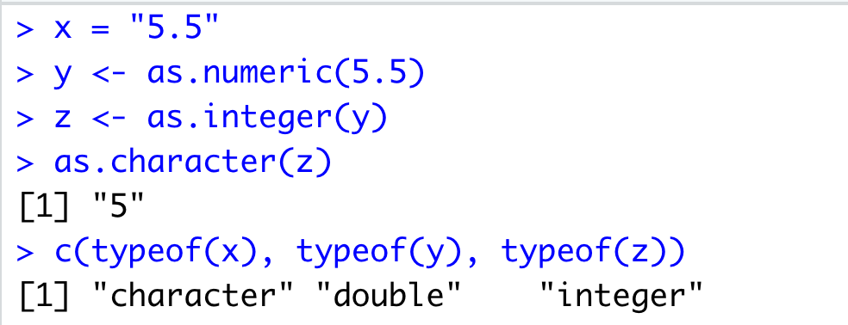
Topic: Basic Variable/Data Types
When you encounter new data and want to know its data type you can use the function typeof().
When you want to change a variables data type use the as.XXX functions e.g. as.character() takes input data and returns a character. as.integer() takes numeric variables and returns an integer etc.
Example:

Slide 7
Topic: Vectors in R
In this class we will be handling data, which can be organized into different data structures: vector, lists, matrices, data frames etc.
The most basic data structure is a vector, in R we can make vectors using the c(arg 1, arg 2, …) function (the c stands for combine)
Ex: > vec_of_ones <- c(1.0, “1”, as.integer(1))
There are many functions in R to help make or analyze vectors such as rep(x, int y) which makes a vector that repeats x, y times.
Ex: > ones_and_twos <- rep(c(1,2), 4)
To be a sequence of numbers use the seq() command. Type > ?seq into the console to learn more!
Ex: > seq(2,10,2)
Ex: > 2:8 # the colon operator will generate vector of ints between 2 and 8

Slide 8
Topic: Vectors in R
We can access specific elements of a vector by using brackets []
Example:
> one_to_six <- c(“one”, “two”, “three”, “four”, “five”, “six”)
> odds = c(one_to_ten[1], one_to_ten[3], one_to_ten[5])
The [5] tells R to return the element of the vector at the fifth position. In R brackets always take in indexes!
Instead of giving R one index at a time, we can give it a vector of indices.
Example:
> indices = c(2,4,6)
> even <- one_to_six[indicies]
OR
> evens <- one_to_six[c(2,4,6)]

Slide 9
Topic: Logical Operators
R can do logical operators using/returning Logical variables that can be extremely helpful.
Main logical operators:
>= greater than or equal, <= less than or equal, > greater than, < less than
Example:
> data <- runif(10) # This command generates 10 random elements from uniform[0,1]
> paste("The sum is greater than 5?", sum(data) >= 5, sep =" ")
== Check if two things are equal
Example:
> data1 = runif(10)
> data2 = runif(20, 0, .5) # This command generates 10 random elements from uniform[0, .5]
> as.integer(sum(data1)) == as.integer(sum(data2))
!= Check if two things are unequal
Example:
> as.integer(sum(data1)) != as.integer(sum(data2))

Slide 10
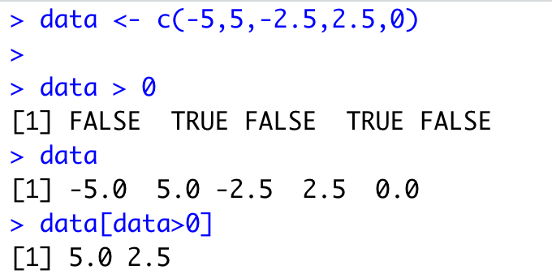
Topic: Logical Operators + Vectors
Logical operations can be combined with vectors for convenient data processing.
Applying logical operators to vectors creates vectors of logical operators
Example:
When you pass a vector of logicals as indices, it returns the elements of the vector for which the indexing vector was true i.e. in the vector: data > 0, the second and fourth index are TRUE. Thus data[data > 0] returns the second and fourth elements of data!

Slide 11
For Next Time
Next time we will continue talking about vectors and introduce new data structures: Lists and Dataframes. We will also introduce functions!
For additional practice: Complete swirl lessons (~15 Mins Each)
3: Sequences of Numbers
4: Vectors
6: Subsetting Vectors in the course “R Programming”.

